Slide 1
BMIDE for codeful customization.
By: Jaikumar Pardeshi

Slide 2
Agenda
Configure bmide.bat
Create BMIDE Template Project.
Configure BMIDE Project for codeful customization.
Generate C++ code in BMIDE.
Explore the BMIDE project folder structure.
Codeful customization using BMIDE.
Explore makefile.wntx64
Explore makefile for custom library
Explore the src folder of BMIDE.
Explore output folder.
How to Build custom code using BMIDE.
Data model customization framework

Slide 3
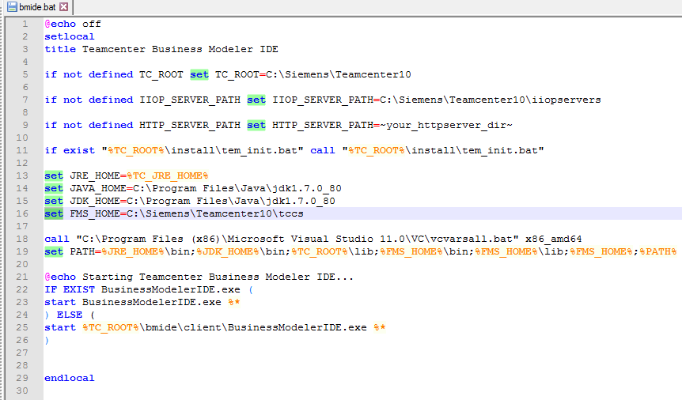
Configure bmide.bat file
Open ~TC_ROOT\bmide\client\bmide.bat in notepad.
Set the following variables in bmide.bat:
JAVA_HOME
JDK_HOME
FMS_HOME
Find the location where appropriate version of Visual Studio is installed.
Add the entry of vcvarsall.bat as shown in the image.
Open Teamcenter command prompt.
Launch this modified bmide.bat from Teamcenter command prompt. This will open BMIDE for you.

Slide 4
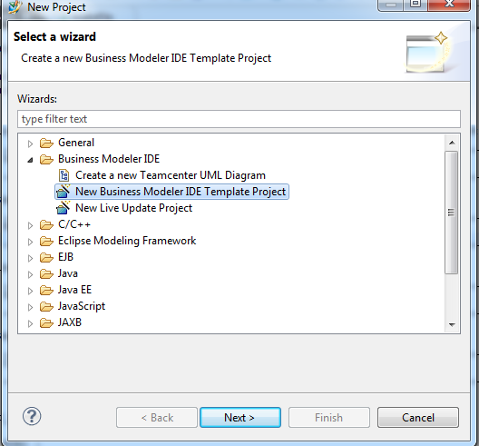
Create a BMIDE Template Project
Open BMIDE.
File -> New -> Project
Select “New Business Modeler IDE Template Project” as shown in the image.

Slide 5
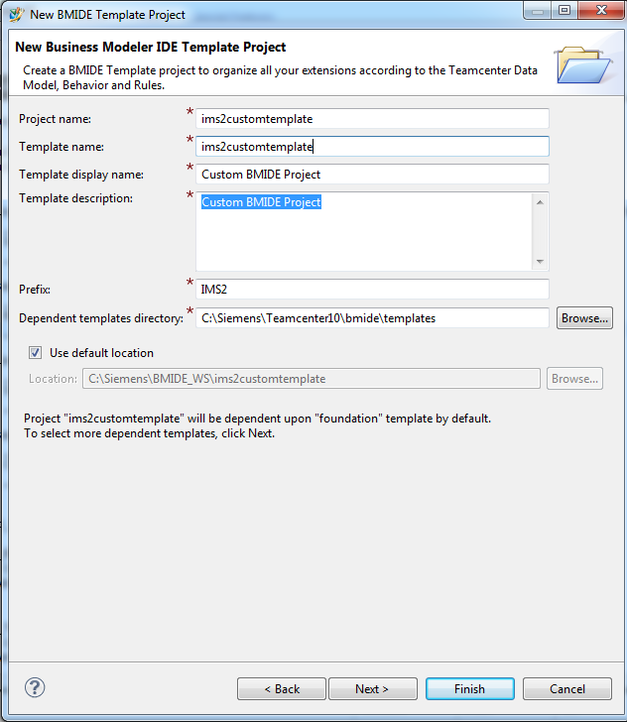
Create a New BMIDE Template Project

Slide 6
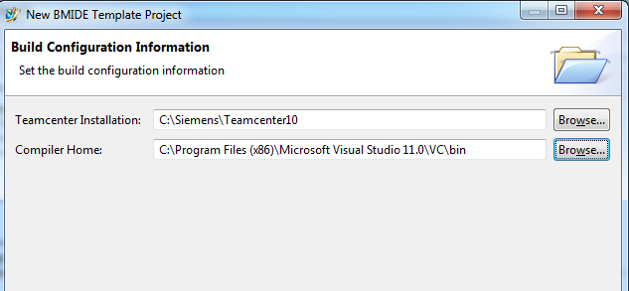
Setting up a BMIDE project for codeful customization

Slide 7
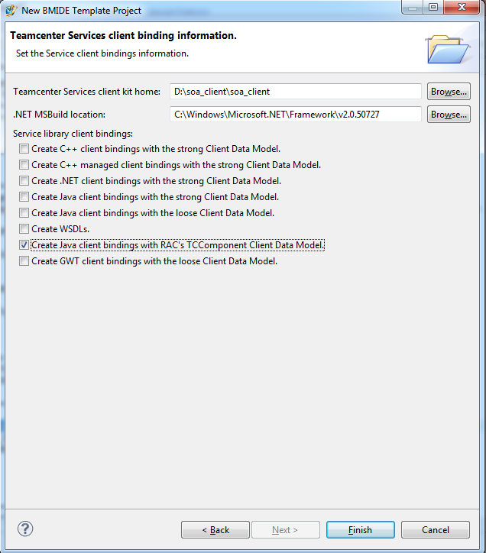
Binding type to generate for SOA.

Slide 8
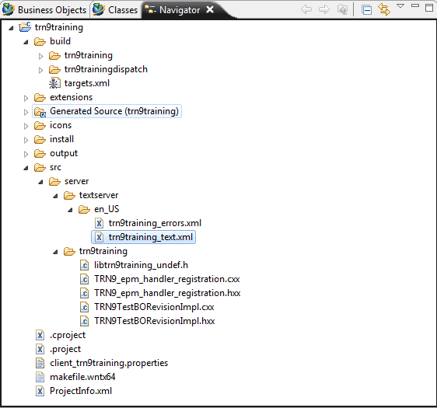
Generate C++ code in BMIDE.
Select BMIDE project in “Business Objects” tab
RMB-> Generate Code -> C++ Classes.
Plumbing code gets generated in folder src\server\<library_name> as shown in the image.

Slide 9
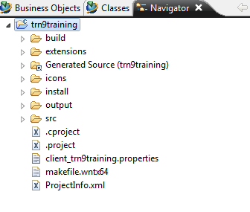
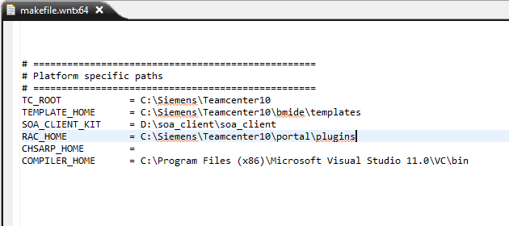
Path variables in makefile.wntx64
Project configurations defined in makefile.wntx64

Slide 10
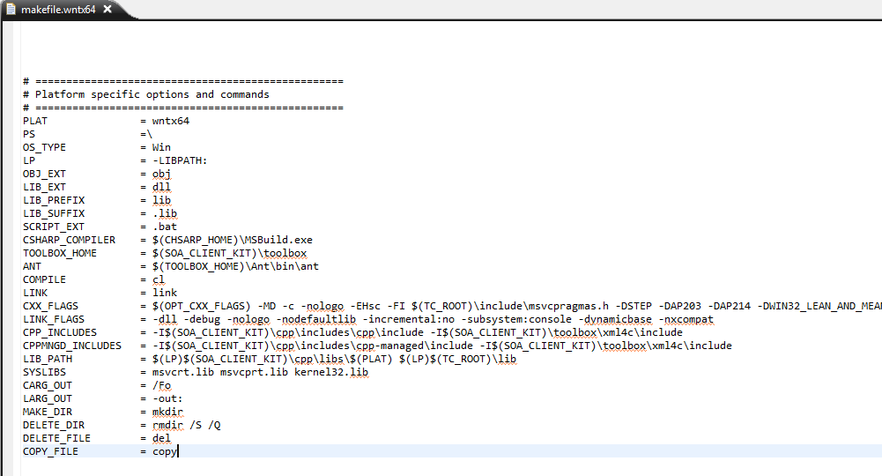
Build related variables in makefile.wntx64

Slide 11
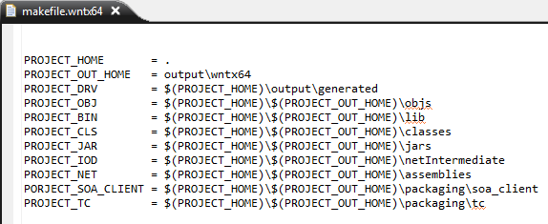
Relative Project locations in makefile.wntx64

Slide 12
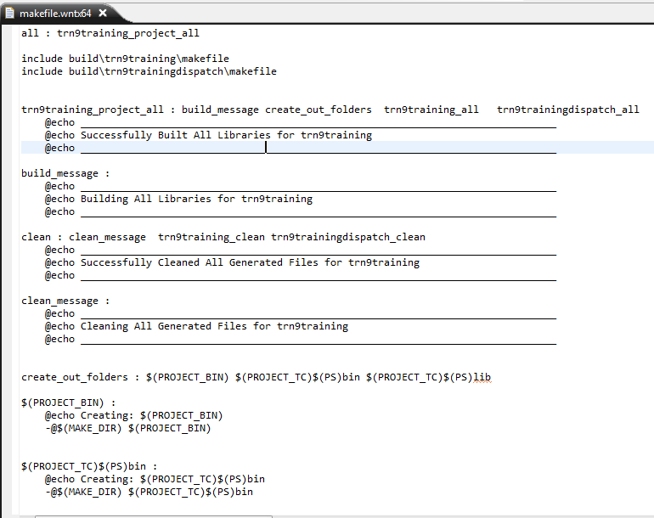
Build tokens in makefile.wntx64

Slide 13
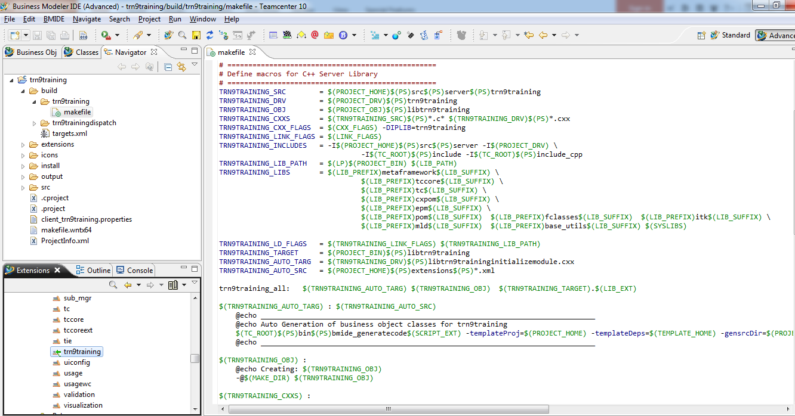
makefile for custom library

Slide 14
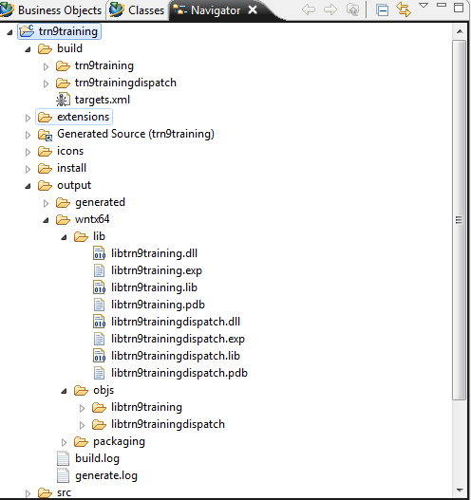
output folder containing the build output.
The build and output folders are dynamic and are bound to change whenever a user generates the C++ code .
A user can delete the output and build folder completly and they get regenrated whenever C++ code is regenerated.
The content in src folder remains unaffected.
If a user has added a new Extension in BMIDE then the .hxx and .cxx files for the same would get generated in src folder whenever a user regenerates the C++ code.
If an Extension is deleted from BMIDE then regeneration of C++ code does not remove the corresponding files from src folder, you have to explicitly remove them from the src folder.
NOTE: The src folder is closed for modification but open for Addition.

Slide 15
Need for Data model customization framework
Need :
Prior to Teamcenter 8, customizers wrote business logic everywhere: the rich client, ITK, C++,
services, and so on. This was not a good practice. By having business logic in the rich client, other clients did not get that business logic, and by having business logic in ITK, customizers did not get override capability and extensibility (pre-conditions, pre-actions, and post-actions). Having this inconsistency in the location made business logic difficult to maintain, and some business logic could get executed only in certain paths. Hence the need for Data model customization framework was felt.
Benifits :
The framework provides the solution to this problem. It isolates business logic in one location i.e.
the Impl class.
The data model customization framework supports a single coherent mechanism for developing new
business functionality by defining business logic on the business objects.

Slide 16
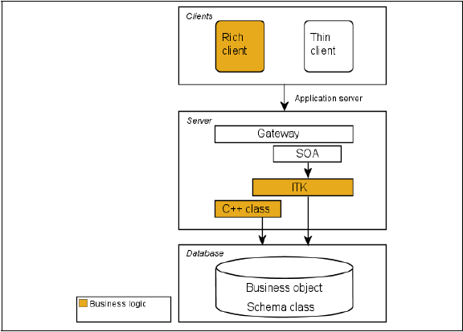
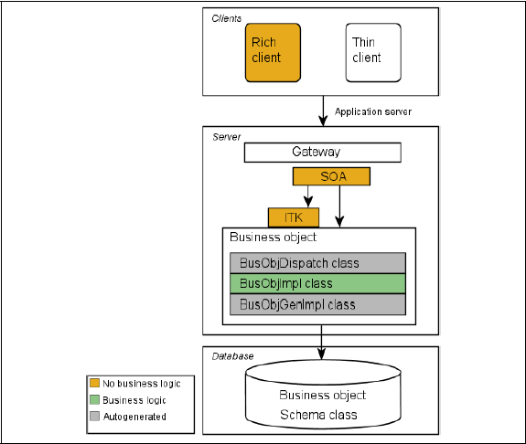
Teamcenter interaction prior to Teamcenter 8
Teamcenter interaction after Teamcenter 8

Slide 17
Data model customization framework
The data-model-based customization framework supports a single coherent mechanism for
developing new functionality using C++. The framework:
• Defines business logic on business objects in the Impl class of the business object.
• Provides a consistent approach that can be used for internal Siemens PLM Software development
as well as for external customizations.
• Is scalable (delayed loading of DLLs).
• Exposes the business logic API in an object-oriented way (through interfaces).
• Improves memory performance.
Using the BMIDE, you can autogenerate the C++ plumbing code required to
implement the business logic. This:
• Reduces implementation time.
• Increases productivity because you can spend more time in writing business logic.
• Enforces coding standards.
• Aids future enhancements.

Slide 18
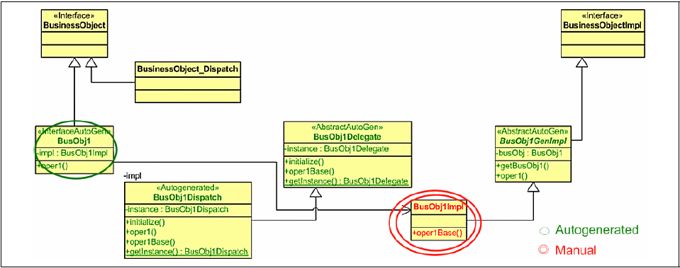
Data model customization framework paradigm
Framework Interfaces

Slide 19
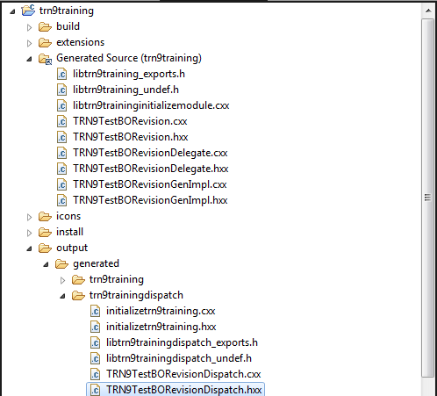
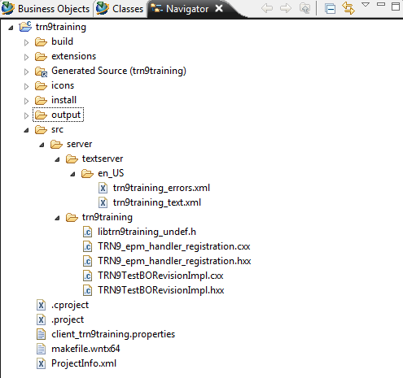
Data model customization framework paradigm
Autogenerated files
Implementation file

Slide 20
Framework Interfaces
Class | Auto generated | Purpose
Interface | Yes | C++ interface class. Defines published/unpublished API. All server caller code dependent on this business object works with only this interface.
Dispatch | Yes | Implements the interface. Provides the overriding and extensibility (pre/post) capabilities to the business object.
General Implementation ( GenImpl ) | Yes | C++ abstract Class. This class provides methods to get/set attribute values in the database and any other helper methods needed by the implementation.
Delegate | Yes | C++ abstract class. This class breaks the direct dependency between the dispatch and implementation classes.
Implementation ( Impl ) | No | Implementation class. The developer implements the core business logic for the business object in this class.

Slide 21
What did we learn ?
Create and Configure BMIDE Project for codeful customization.
Generate serverside custom code using BMIDE.
Explore the BMIDE project folder structure.
Codeful customization using BMIDE.
Elements of makefile.wntx64.
Explore makefile for custom library.
Explore the src folder of BMIDE.
Explore output folder.
How to Build custom code using BMIDE ?
Data model customization paradigm.

